Slide 1
Meek players
#asgj4 #meekplayers

Slide 2

Gameplay video

Slide 3
Core ideas
‘Cooking mama’ style game
Cartoon graphics
Both education and fun
Gamification (points, score boards)
2 game modes:
Practice mode (Assessed/Different scores)
Make mode

Slide 4
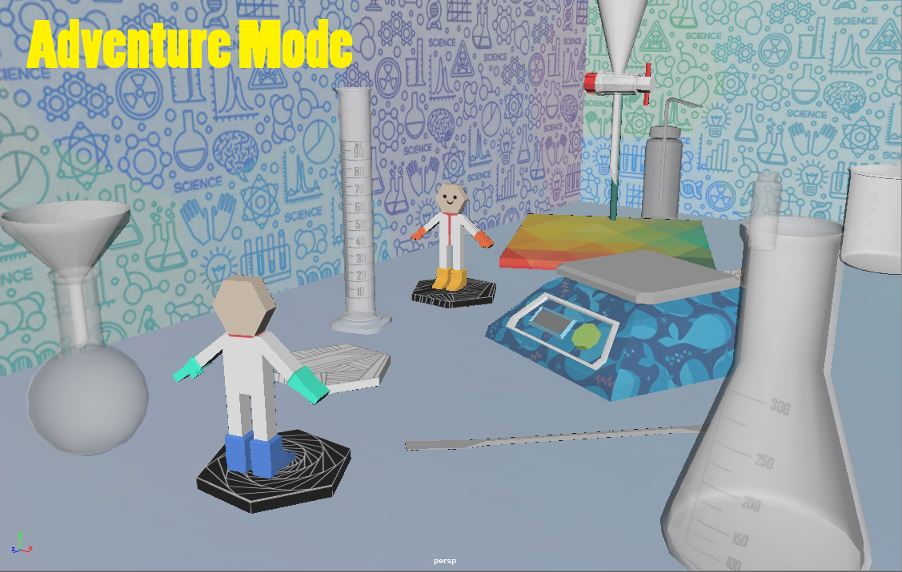
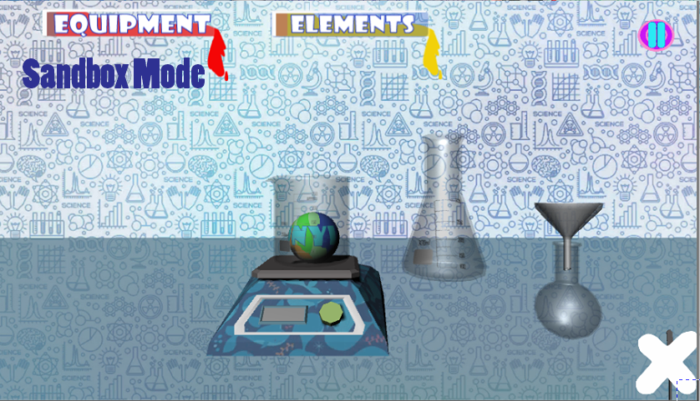
2 game modes

Slide 5
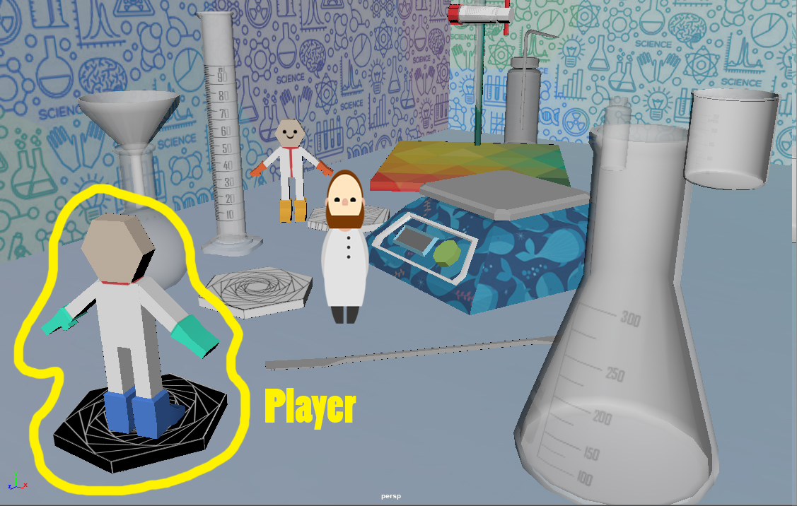
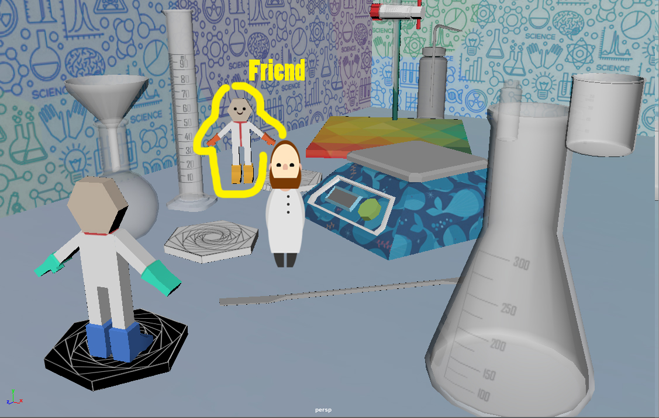
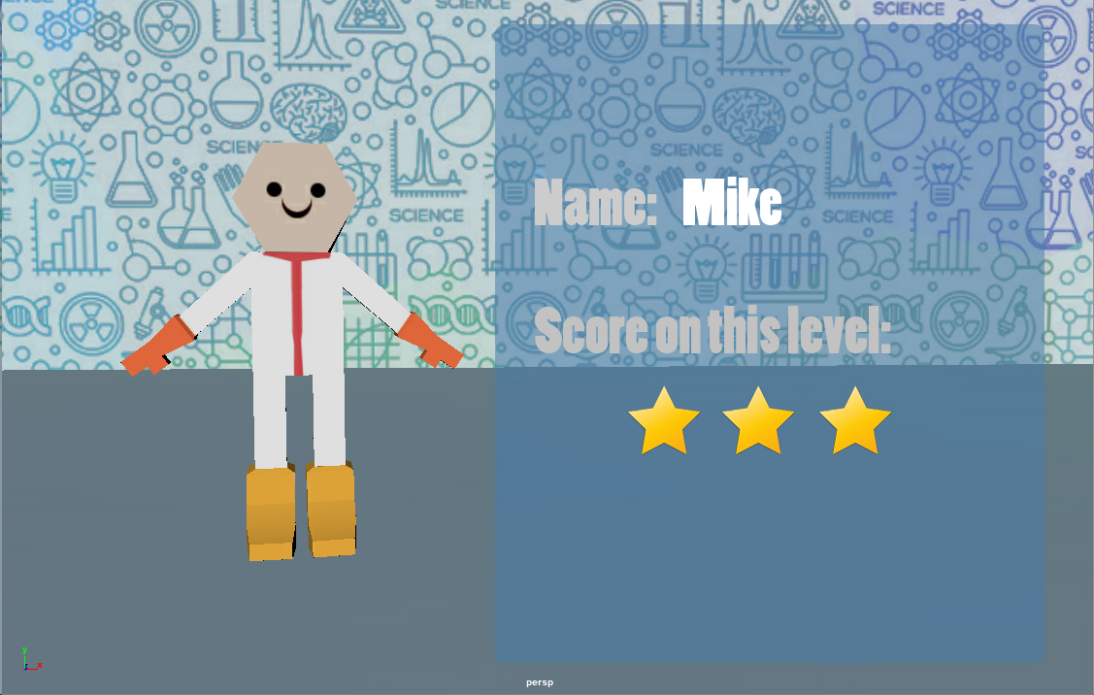
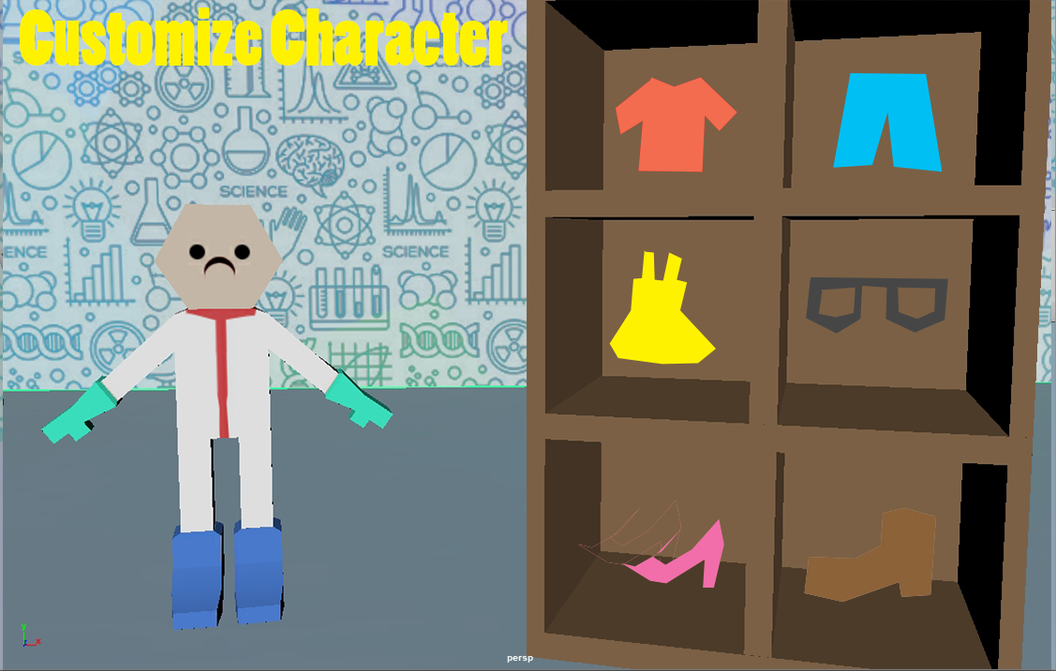
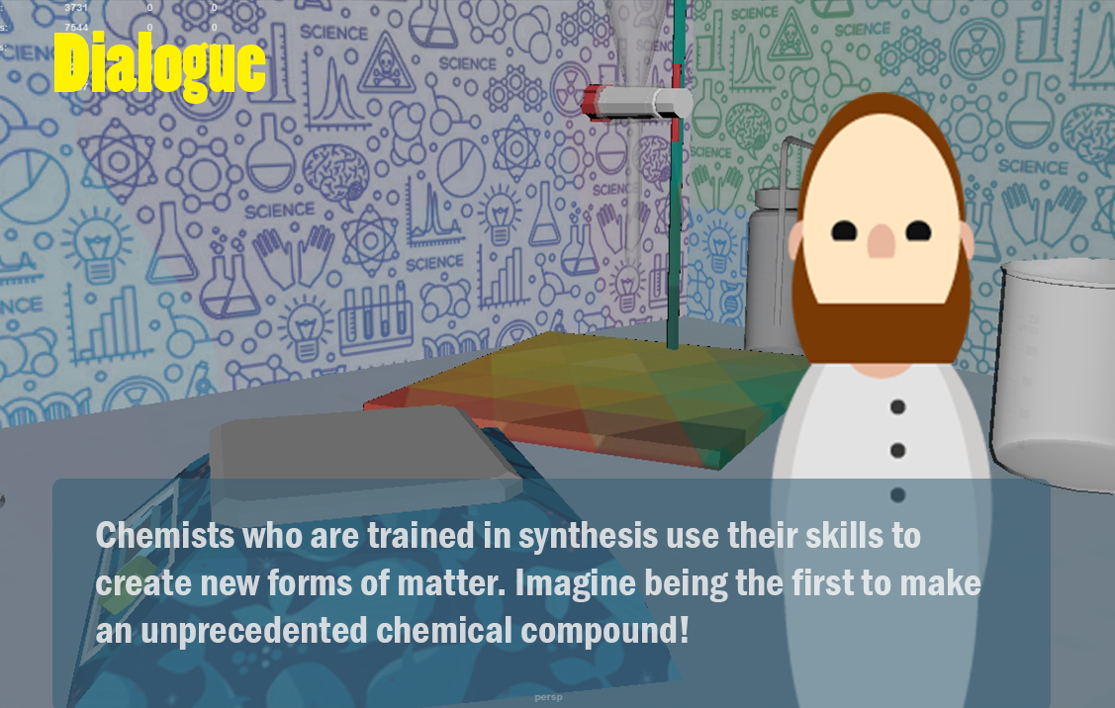
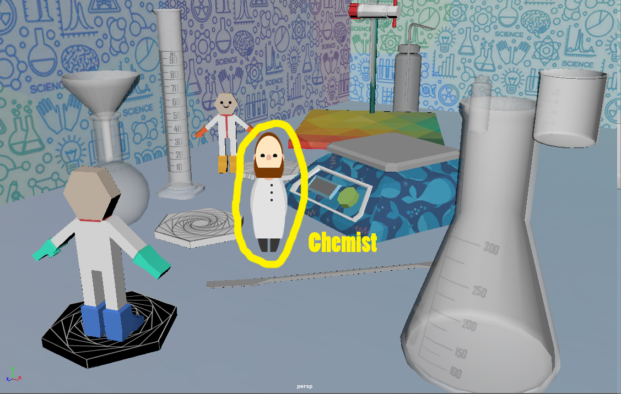

Slide 6
ideas
Different experiments
Experiments being assessed (0-100% scale, 0-3 stars scale)
Student score board
Experiment can go wrong
Putting together equipment
Badly put: red outline around the glassware
Well put: green outline around the glassware

Slide 7

Concept art

